Slide 1
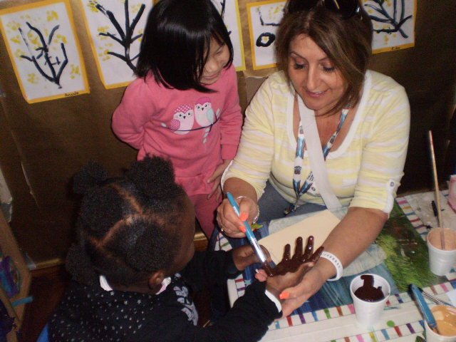
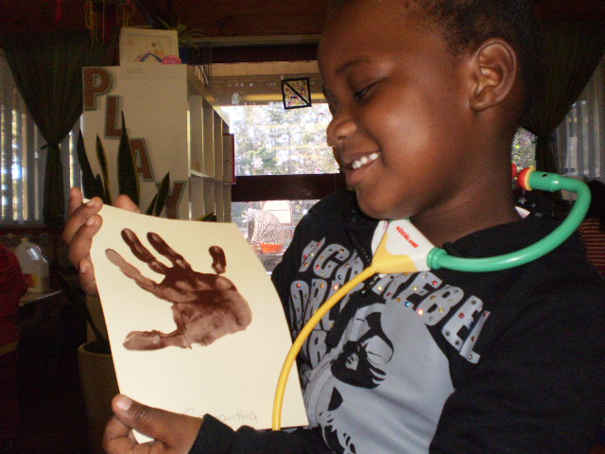
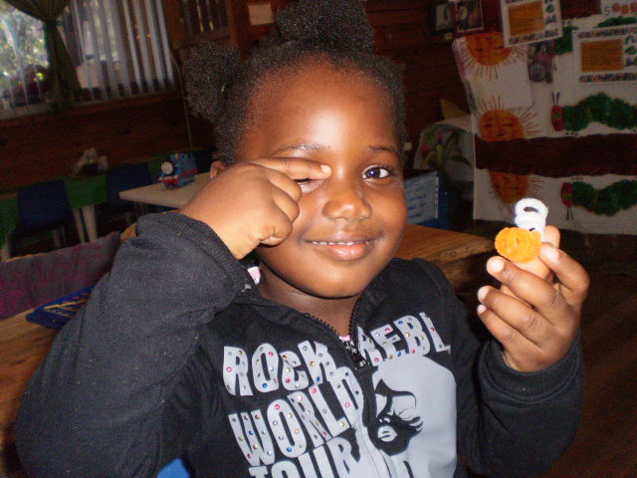
“This is me!”

Slide 2
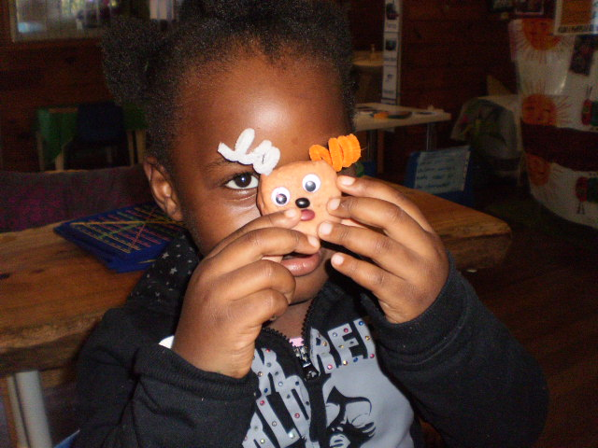
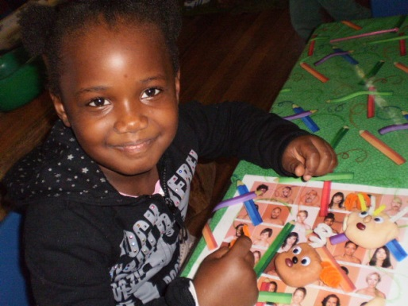
Analysis of Learning
Samantha, you are an absolutely beautiful girl and I am so glad that you think so too. I love watching your pride and joy in sharing with others your beautiful skin colour and your beautiful hair, eyes, nose and mouth! I am glad to see that you are so confident in knowing and understanding who you are and I hope you keep developing this confidence in your self identity in the future.
Links to EYLF:
Learning Outcome 1- Samantha is developing knowledgeable and confident self identity.
What Next?
Continue to provide rich and diverse resources that reflect Samantha’s and her peers’ social world.
Continue to develop Samantha’s understanding of herself by inviting her mum to share her hair braiding skills or to cook a traditional meal from her culture.
Written by Ms Lien Chai
Samantha, when Ms Anna called you over to find your skin colour paint, you picked the beautiful dark brown right away. I watched you gaze at your handprint with so much pride. When you came over to me at the play dough table I asked you to look at the pictures and pick one who looks like you. Right away you pointed to an African American looking woman and said “this is me” I asked you to find a play doh colour that matched your skin. You chose brown and we began talking about adding eyes, nose and mouth. When it was time to add the hair I’m glad you chose the curly pipe cleaners because they do remind me of all your lovely curls. When you finished your play dough face, you kept pointing to its eyes and then your own eyes, you did the same to the nose and mouth, showing me that your play dough face represented your face. When you finally finished you tuned to me and announce “Ms En, this is me, me is so cute!”. I laughed and agreed that yes you are so cute. You then went over to Ms Anna and showed her saying “I’m so pretty”. When we were outside you found a nurse that had dark skin, you showed it to Ms Theresa and said “This is me” you then opened up your sleeve, stroking your skin and said “Look I’m so beautiful”.

